Slide 1
Global Sales Dashboard – Business Insights Using Tableau
Presented By: Chandan Kumar Sah

Slide 2
Objective:
To design an interactive sales dashboard to help stakeholders monitor key KPIs, product performance, and market trends.
Tools Used:
Tableau (Data Visualization)

Slide 3
Dataset Summary
Dataset Name: sales_data_sample.csv
Source: Kaggle
Key Fields:
OrderDate, OrderNumber, Sales, ProductLine, Country, DealSize, CustomerName
Rows: 2823
Columns: 25

Slide 4
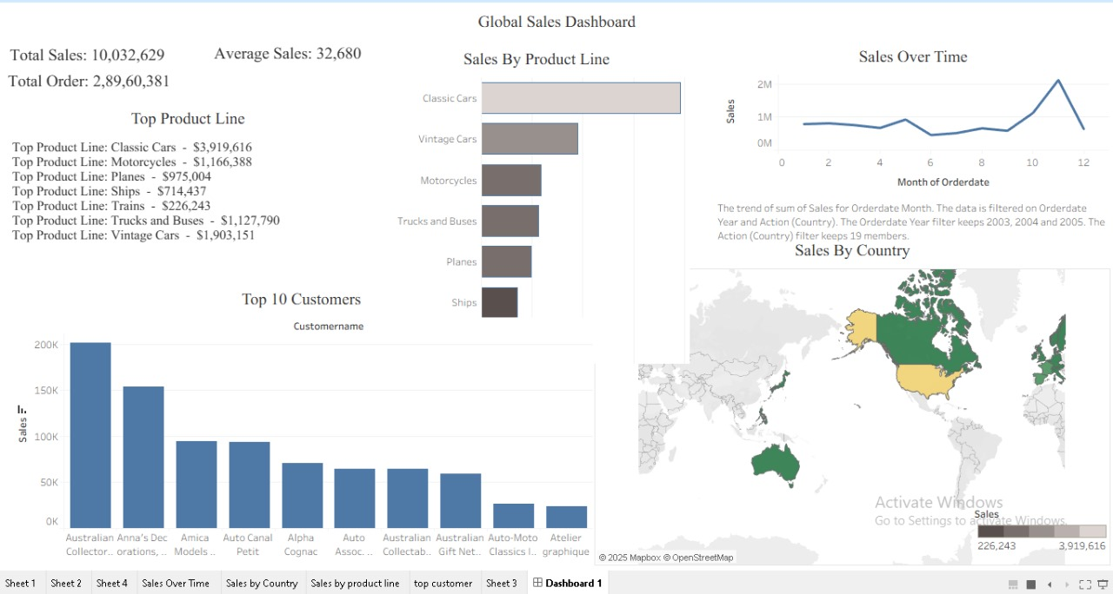
Dashboard Preview

Slide 5
Key KPIs & Interactivity
KPIs Shown:
• Total Sales
• Total Orders
• Average Sale per Order
• Top Product Line
Interactive Filters Used:
• Year
• ProductLine
• Country
• DealSize
Actions Enabled:
• Dropdown Filters
• Highlighting
• Top N Filtering

Slide 6
Insights & Conclusion
Insights:
The Classic Cars product line had the highest total sales.
The majority of large deals came from USA and France.
Sales peaked in Q4, aligning with end-of-year demand.
Conclusion:
The dashboard enables quick exploration of global sales data, highlighting trends, customer behavior, and product performance to support decision-making.

